Slide 1

Syntax, Functions and Statements
Operators, Parameters, Return Value, Arrow Functions
SoftUni Team
Technical Trainers
Software University
https://softuni.bg

Slide 2
Table of Contents
Introduction to JavaScript
Data Types and Variables
Operators and Statements
Debugging Techniques
Functions & Hoisting
<number>
Notes:
<number>
© SoftUni – https://softuni.org. Copyrighted document. Unauthorized copy or reproduction is not permitted.

Slide 3
Have a Question?
sli.do
#js-advanced
<number>
Notes:
<number>
© SoftUni – https://softuni.org. Copyrighted document. Unauthorized copy or reproduction is not permitted.

Slide 4

JavaScript Overview
Definition, Execution, IDE Setup

Slide 5
What is JavaScript?
JavaScript (JS) is a high-level programming language
One of the core technologies of the World Wide Web
Enables interactive web pages and applications
Can be executed on the server and on the client
Features:
C-like syntax (curly-brackets, identifiers, operator)
Multi-paradigm (imperative, functional, OOP)
Dynamic typing
3

Slide 6
Dynamic Programming Language
JavaScript is a dynamic programming language
Operations otherwise done at compile-time can be done at run-time
It is possible to change the type of a variable or add new properties or methods to an object while the program is running
In static programming languages, such changes are normally not possible
6

Slide 7


Live Demonstration
Setting up Node.js + VS Code

Slide 8


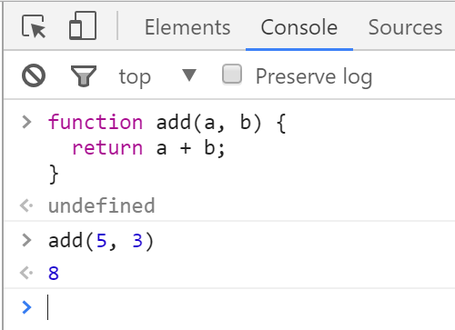
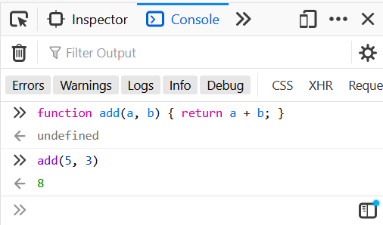
Chrome Web Browser
Developer Console: [F12]
8

Slide 9
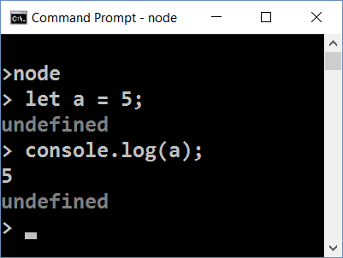
Node.js
What is Node.js?
Server-side JavaScript runtime
Chrome V8 JavaScript engine
NPM package manager
Install node packages
<number>

Slide 10
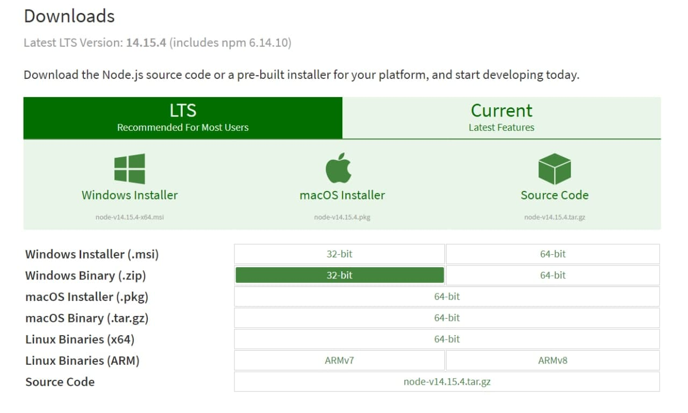
Install the Latest Node.js
<number>

Slide 11
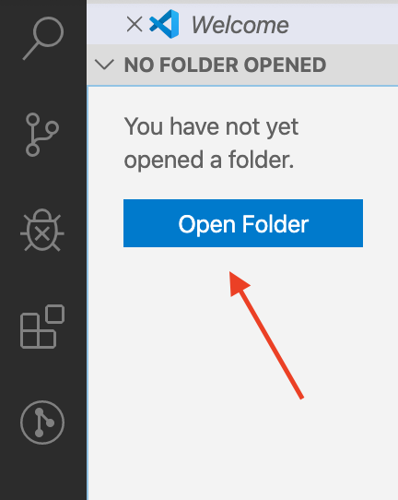
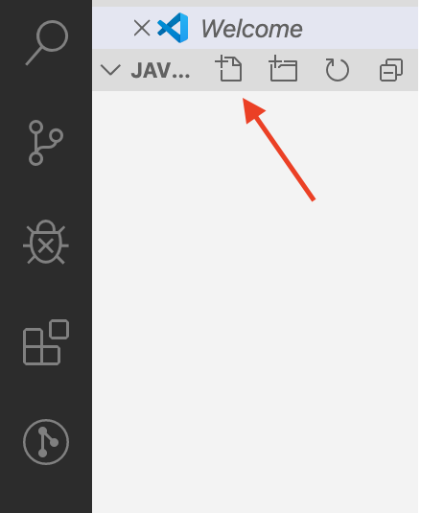
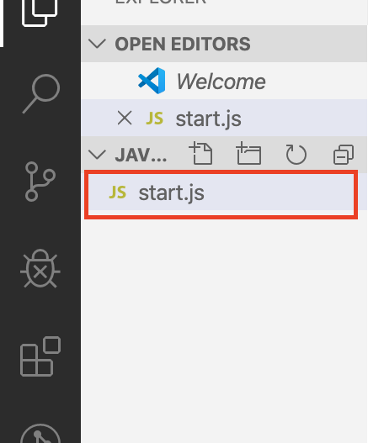
Using Visual Studio Code
Visual Studio Code is powerful text editor for JavaScript and other projects
In order to create your first project:
<number>

Slide 12

Data Types & Variables
Identifiers, Declaring Variables, Variable Scope

Slide 13
Data Types
Seven data types that are primitives
String - used to represent textual data
Number - a numeric data type
Boolean - a logical data type
Undefined - automatically assigned to variables
Null - represents the intentional absence of any object value
BigInt - represent integers with arbitrary precision
Symbol - unique and immutable primitive value
Reference types – Object
13

Slide 14
Identifiers
An identifier is a sequence of characters in the code that identifies a variable, function, or property
In JavaScript, identifiers are case-sensitive and can contain Unicode letters, $, _, and digits (0-9), but may not start with a digit
let _name = "John";
function $sum(x, y) {
return x + y;
}
let 9 = 'nine'; //SyntaxError: Unexpected number
14

Slide 15
Variable Values
Used to store data values
Variables that are assigned a non-primitive value are given a reference to that value
Undefined - a variable that has been declared with a keyword, but not given a value
Undeclared - a variable that hasn't been declared at all
let a;
console.log(a) //undefined
console.log(undeclaredVariable);
//ReferenceError: undeclaredVariable is not defined
14

Slide 16
Variable Values (2)
let, const and var are used to declare variables
let - allows reassignment
const - once assigned it cannot be modified
var - defines a variable in the function scope regardless of block scope
let name = "George";
name = "Maria";
const name = "George";
name = "Maria"; // TypeError
var name = "George";
name = "Maria";
14

Slide 17
Legacy Variable Declaration
You will see var used in old examples
Using var to declare variables is a legacy technique
Since ES2015 keywords let and const are available
var introduces function scope hoisting
Will be discussed later in the lesson
There is no good reason to ever use var!
14

Slide 18
Variable Scopes
Global scope – Any variable that’s NOT inside any function or block (a pair of curly braces);
Functional scope – Variable declared inside a function is inside the local scope;
Block scope – let and const declares block scoped variables
14

Slide 19
Dynamic Typing
Variables in JavaScript are not directly associated with any particular value type
Any variable can be assigned (and re-assigned) values of all types
NOTE: The use of dynamic typing is considered a bad practice!
let foo = 42; // foo is now a number
foo = 'bar'; // foo is now a string
foo = true; // foo is now a boolean
19

Slide 20

Functions
Declaring and Invoking

Slide 21
Functions
Function - named list of instructions (statements and expressions)
Can take parameters and return result
Function names and parameters use camel case
The { stays at the same line
Invoke the function
function printStars(count) {
console.log("*".repeat(count));
}
printStars(10);
<number>

Slide 22
Declaring Functions
Function declaration
Function expression
Arrow functions
function walk() {
console.log("walking");
}
const walk = function () {
console.log("walking");
}
const walk = () => {
console.log("walking");
}
<number>

Slide 23
Parameters and Returned Value
You can receive parameters with no value
The unused parameters are ignored
Functions can yield a value with the return operator
function foo(a,b,c){
console.log(a);
console.log(b);
console.log(c); //undefined
}
foo(1,2)
function foo(a,b,c){
console.log(a);
console.log(b);
console.log(c);
}
foo(1,2,3,6,7)
function identity(param){
return param;
}
console.log(identity(5)) // 5
<number>

Slide 24
Object Methods and Standard Library
Any object may have methods
Functions that operate from the context of the object
Accessed as a property using the dot-notation
JavaScript has a large standard library
Math, Number, Date, RegExp, JSON and more
For more information,
let myString = 'Hello, JavaScript!';
console.log(myString.toLowerCase());
// hello, javascript!
24

Slide 25
Problem: Echo Function
A string argument is passed to your function
Print on separate lines:
The length of the input parameter (number of characters)
The unchanged parameter itself
18
Hello, JavaScript!
'Hello, JavaScript!'
16
strings are easy
'strings are easy'
24

Slide 26
Solution: Echo Function
function echo(inputAsString) {
let stringLength = inputAsString.length;
console.log(stringLength);
console.log(inputAsString);
}
echo('Hello, JavaScript!');
// 18
// Hello, JavaScript!
25

Slide 27

Default Function Parameter Values
Functions can have default parameter values
function printStars(count = 5) {
console.log("*".repeat(count));
}
printStars(); // *****
printStars(2); // **
printStars(3, 5, 8); // ***
<number>

Slide 28

Operators and Statements
Assignment, Arithmetic, Comparison, Logical

Slide 29
Arithmetic Operators
Arithmetic operators - take numerical values (either literals or variables) as their operands
Return a single numerical value
Addition (+)
Subtraction (-)
Multiplication (*)
Division (/)
Remainder (%)
Exponentiation (**)
let a = 15;
let b = 5;
let c;
c = a + b; // 20
c = a - b; // 10
c = a * b; // 75
c = a / b; // 3
c = a % b; // 0
c = a ** b;//15⁵ = 759375
<number>

Slide 30
Assignment Operators
Assignment operators - assign a value to its left operand based on the value of the right operand
Name
Shorthand operator
Basic usage
Assignment
x = y
x = y
Addition assignment
x += y
x = x + y
Subtraction assignment
x -= y
x = x - y
Multiplication assignment
x *= y
x = x * y
Division assignment
x /= y
x = x / y
Remainder assignment
x %= y
x = x % y
Exponentiation assignment
x **= y
x = x ** y
30

Slide 31
Problem: String Length
Receive three string arguments as input
Calculate the total length of all strings
Calculate the average length, rounded down
Print the result on the console
22
7
'chocolate', 'ice cream', 'cake'
10
3
'pasta', '5', '22.3'
30

Slide 32
Solution: String Length
function solve(str1, str2, str3) {
let len1 = str1.length;
let len2 = str2.length;
let len3 = str3.length;
let sumLength = len1 + len2 + len3;
let averageLength = Math.floor(sumLength / 3);
console.log(sumLength);
console.log(averageLength);
}
31

Slide 33
Comparison Operators
Operator | Notation in JS
EQUAL value EQUAL value and type | == ===
NOT EQUAL value NOT EQUAL value or type | != !==
GREATER than | >
GREATER than OR EQUAL | >=
LESS than | <
LESS than OR EQUAL | <=
31

Slide 34

Comparison Operators
console.log(1 == '1'); // true
console.log(1 === '1'); // false
console.log(3 != '3'); // false
console.log(3 !== '3'); // true
console.log(5 < 5.5); // true
console.log(5 <= 4); // false
console.log(2 > 1.5); // true
console.log(2 >= 2); // true
console.log((5 > 7) ? 4 : 10); // 10
Ternary operator
<number>

Slide 35
Conditional Statements
The if-else statement:
Do action depending on condition
You can chain conditions
let a = 5;
if (a >= 5) {
console.log(a);
}
If the condition is met, the code will execute
else {
console.log('no');
}
Continue on the next condition, if the first is not met
<number>

Slide 36
Truthy and Falsy Values
"truthy" - a value that coerces to true when evaluated in a boolean context
The following values are "falsy" - false, null, undefined, NaN, 0, 0n and ""
logTruthiness (3.14); //Truthy!
logTruthiness ({}); //Truthy!
logTruthiness (NaN); //Falsy.
logTruthiness ("NaN"); //Truthy!
logTruthiness ([]); //Truthy!
logTruthiness (null); //Falsy.
logTruthiness (""); //Falsy.
logTruthiness (undefined); //Falsy.
logTruthiness (0); //Falsy.
function logTruthiness (val) {
if (val) {
console.log("Truthy!");
} else {
console.log("Falsy.");
}
}
<number>

Slide 37
Logical Operators
&& (logical AND) - returns the leftmost "false" value or the last truthy value, if all are true.
|| (logical OR) - returns the leftmost "true" value or the last falsy value, if all are false.
const val = 'yes' && null && false
console.log(val); // null
const val1 = true && 5 && 'yes';
console.log(val1); // 'yes'
const val = false || '' || 5;
console.log(val); // 5
const val1 = null || NaN || undefined;
console.log(val1); // undefined
37

Slide 38

Logical Operators (2)
! (logical NOT) - Returns false if its single operand can be converted to true; otherwise, returns true
const val = !true
console.log(val); // false
const val = !false;
console.log(val); // true
<number>

Slide 39
Problem: Largest Number
Three number arguments passed to your function as an input
Find the largest of them
Print the result on the console
Tip: Use interpolated strings to format the result
3, 4, 5
The largest number is 5.
7, 11, 2
The largest number is 11.
`3 + 5 = ${3 + 5}` // 3 + 5 = 8
<number>

Slide 40
Solution: Largest Number
function firstSolution(x, y, z) {
let result;
if (x >= y && x >= z) {
result = x;
} else if (y >= x && y >= z) {
result = y;
} else {
result = z;
}
console.log(`The largest number is ${result}.`);
}
function secondSolution(...params) {
console.log(`The largest number is ${Math.max(...params)}.`);
}
39

Slide 41
Typeof Operator
The typeof operator returns a string indicating the type of an operand
const val = 5;
console.log(typeof val); // number
const str = 'hello';
console.log(typeof str); // string
const obj = {name: 'Maria', age:18};
console.log(typeof obj); // object
39

Slide 42
Problem: Circle Area
Write a function that takes a single parameter as an input
Calculate the area of a circle, with the parameter as radius
If the parameter is not a number, print an error message
Include the type of parameter in the message
Print the result on the console, rounded to the second decimal
5
78.54
We can not calculate the circle area, because we receive a string.
'name'
39

Slide 43
Solution: Circle Area
function solve(radius) {
let inputType = typeof(radius);
if (inputType === 'number') {
let area = Math.pow(radius, 2) * Math.PI;
console.log(area.toFixed(2));
} else {
console.log(`We can not calculate the circle area, because we receive a ${inputType}.`);
}
}
39

Slide 44
Some Interesting Examples
Data Types
Truthy and Falsy values
console.log(typeof NaN); //number
console.log(NaN === NaN); //false
console.log(typeof null); //object(legacy reasons)
console.log(new Array() == false); //true
console.log(0.1 + 0.2); //0.30000000000000004
console.log((0.2 * 10 + 0.1 * 10) / 10); //0.3
const variable = []; //empty array
console.log(variable == false); //evaluates true
if (variable) { console.log('True!') }; //'True!'
39

Slide 45
Loops
The for / while loops work as in C++, C# and Java
Classical for-loop
JavaScript supports two more variants of the for-loop:
for-of – used with arrays and iterators
for-in – used with objects and associative arrays
Both will be reviewed in upcoming lessons
for (let i = 0; i <= 5; i++) { console.log(i); }
// 0 1 2 3 4 5
45

Slide 46

Live Demonstration
Lab Problems 5 & 6

Slide 47


Mix HTML and JavaScript
Using JS Code from HTML Page

Slide 48
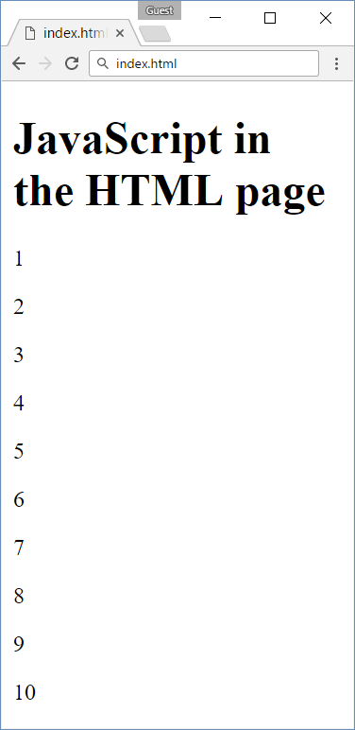
Mixing HTML + JavaScript
<!DOCTYPE html>
<html>
<body>
<h1>JavaScript in the HTML page</h1>
<script>
for (let i=1; i<=10; i++) {
document.write(`<p>${i}</p>`);
}
</script>
</body>
</html>
<number>

Slide 49
Sum Numbers with HTML Form
<form>
num1: <input type="text" name="num1" /> <br>
num2: <input type="text" name="num2" /> <br>
sum: <input type="text" name="sum" /> <br>
<input type="button" value="Sum" onclick="calcSum()" />
</form>
function calcSum() {
let num1 = document.getElementsByName('num1')[0].value;
let num2 = document.getElementsByName('num2')[0].value;
let sum = Number(num1) + Number(num2);
document.getElementsByName('sum')[0].value = sum;
}
<number>

Slide 50
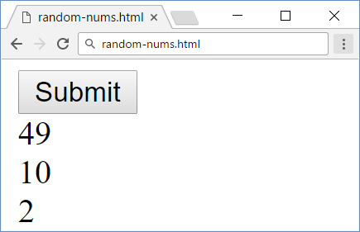
Load JavaScript File from HTML Document
numbers.js
random-nums.html
function printRandNum() {
let num = Math.round(
Math.random() * 100);
document.body.innerHTML +=
`<div>${num}</div>`;
}
<!DOCTYPE html>
<html>
<head>
<script src="numbers.js">
</script>
</head>
<body>
<input type="submit"
onclick="printRandNum()" />
</body>
</html>
<number>

Slide 51

Debugging Techniques
Strict Mode, IDE Debugging Tools

Slide 52
Strict Mode
Strict mode limits certain "sloppy" language features
Silent errors will throw Exception instead
Enabled by default in modules
'use strict'; // File-level
mistypeVariable = 17; // ReferenceError
'use strict'
function strict() {
'use strict'; // Function-level
mistypeVariable = 17;
}
'use strict'

Slide 53
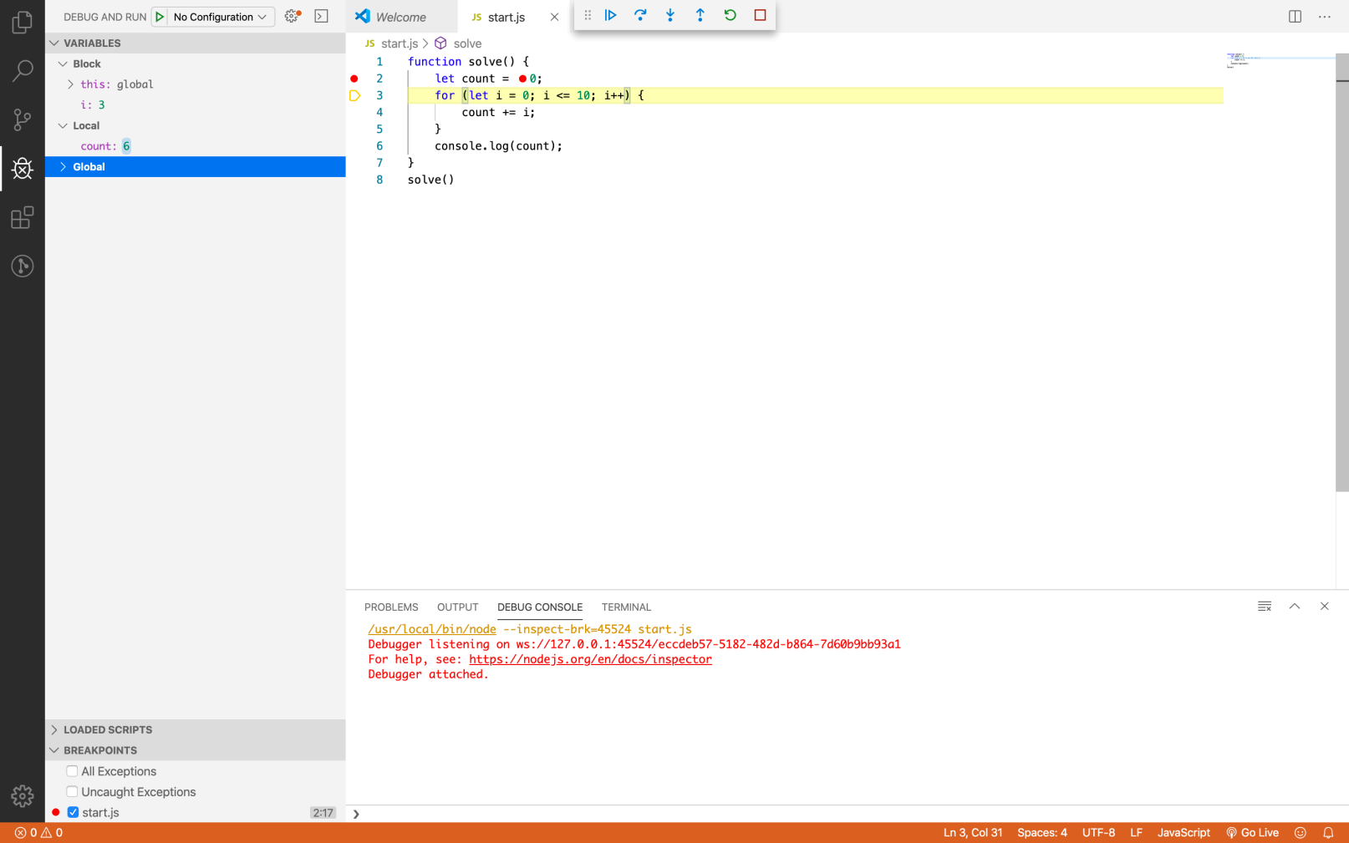
Debugging in Visual Studio Code
Visual Studio Code has a built-in debugger
It provides:
Breakpoints
Ability to trace the code execution
Ability to inspect variables at runtime
<number>

Slide 54
Using the Debugger in Visual Studio Code
Start without Debugger: [Ctrl+F5]
Start with Debugger: [F5]
Toggle a breakpoint: [F9]
Trace step by step: [F10]
Force step into: [F11]
54

Slide 55
Live Demonstration
Lab Problems 7 & 8

Slide 56
Language Specifics
Type Coercion, Functions and Scope

Slide 57
First-class Functions
First-class functions – a function can be passed as an argument to other functions
Can be returned by another function and can be assigned as a value to a variable
function running() {
return "Running";
}
function category(run, type) {
console.log(run() + " " + type);
}
category(running, "sprint"); //Running sprint
Callback
function
57

Slide 58
Nested Functions
Functions can be nested - hold other functions
Inner functions have access to variables from their parent
function hypotenuse(m, n) { // outer function
function square(num) { // inner function
return num * num;
}
return Math.sqrt(square(m) + square(n));
}
3, 4
5
57

Slide 59
Hoisting
Variable and function declarations are put into memory during the compile phase, but stay exactly where you typed them in your code
Only declarations are hoisted
57

Slide 60
Hoisting Variables
console.log(num); // Returns undefined
var num;
num = 6;
num = 6;
console.log(num); // returns 6
var num;
num = 6;
console.log(num); // ReferenceError: num is not defined
let num;
console.log(num); // ReferenceError: num is not defined
num = 6;
57

Slide 61
Hoisting Functions
run(); // running
function run() {
console.log("running");
};
walk(); // ReferenceError: walk is not defined
let walk = function () {
console.log("walking");
};
console.log(walk); //undefined
walk(); // TypeError: walk is not a function
var walk = function () {
console.log("walking");
};
57

Slide 62
Problem: Aggregate Elements
Create function that applies sum, inverse sum and concatenation
Try to use a nested aggregating function
Input will be an array of numbers
Print the result on separate lines on the console
7 // sum: 1 + 2 + 4
3.5 // inverse: 1/1 + 1/2 + 1/4
124 // concat: '1' + '2' + '4'
[1, 2, 4]
57

Slide 63
Solution: Aggregate Elements
function aggregateElements(elements) {
aggregate(elements, 0, (a, b) => a + b);
aggregate(elements, 0, (a, b) => a + 1 / b);
aggregate(elements, '', (a, b) => a + b);
function aggregate(arr, initVal, func) {
let val = initVal;
for (let i = 0; i < arr.length; i++)
val = func(val, arr[i]);
console.log(val);
}
}
62

Slide 64
Summary
…
…
…
JavaScript is a multi-paradigm language
Variables are used to store data references
let, const and var are used to declare variables
Arithmetic operators take numerical values as their operands
Functions can:
Take parameters and return result
Hold other functions inside them
64
Notes:
<number>
© SoftUni – https://softuni.org. Copyrighted document. Unauthorized copy or reproduction is not permitted.

Slide 65
Questions?
Notes:
<number>
© SoftUni – https://softuni.org. Copyrighted document. Unauthorized copy or reproduction is not permitted.

Slide 66












SoftUni Diamond Partners

Slide 67


Educational Partners
<number>

Slide 68

License
This course (slides, examples, demos, exercises, homework, documents, videos and other assets) is copyrighted content
Unauthorized copy, reproduction or use is illegal
© SoftUni – https://about.softuni.bg/
© Software University – https://softuni.bg
<number>
Notes:
<number>
© SoftUni – https://softuni.org. Copyrighted document. Unauthorized copy or reproduction is not permitted.

Slide 69
Trainings @ Software University (SoftUni)
Software University – High-Quality Education, Profession and Job for Software Developers
softuni.bg, about.softuni.bg
Software University Foundation
softuni.foundation
Software University @ Facebook
facebook.com/SoftwareUniversity
Software University Forums
forum.softuni.bg
<number>
Notes:
<number>
© SoftUni – https://softuni.org. Copyrighted document. Unauthorized copy or reproduction is not permitted.

